Slide 1

FDACS
AES Portal
Training Tutorials
https://aeslicensing.fdacs.gov
FDACS | Spring 2025

Slide 2
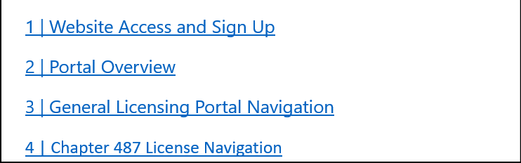

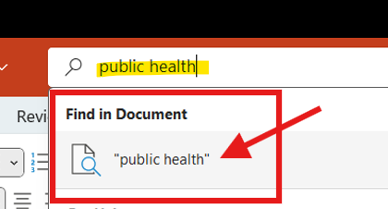
How to Use This Powerpoint Tutorial
Click any linked title throughout this PowerPoint to jump directly to that section. These links serve as shortcuts to navigate throughout the tutorial.
Utilizing the “Search” bar at the top, you can search for any keyword.
  Type in the word and then click the key word under the Find in Document section.
Examples of what to search for: “CEU”, “Business”, “Private”, “Public Health”, “Reports”, etc…

Slide 3

Training Material Overview
  1 | Website Access and Sign Up
  2 | Portal Overview
  3 | General Licensing Portal Navigation
  4 | Chapter 487 License Navigation
  5 | Chapter 388 License Navigation
  6 | Chapter 482 License Navigation
  7 | CEU Portal
  8 | Fumigation Portal
  9 | Reports

Slide 4
1 | Website Access and Sign Up
New User Sign Up
Returning User Login
How to Reset Your Password

Slide 5
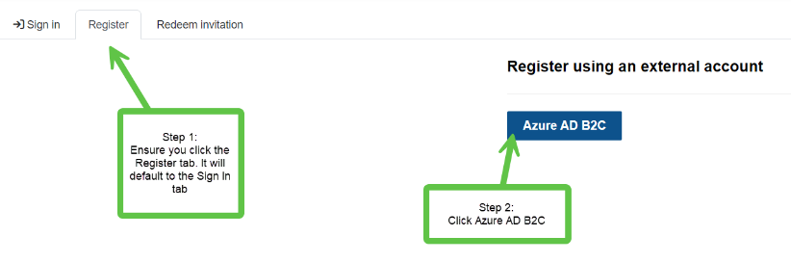
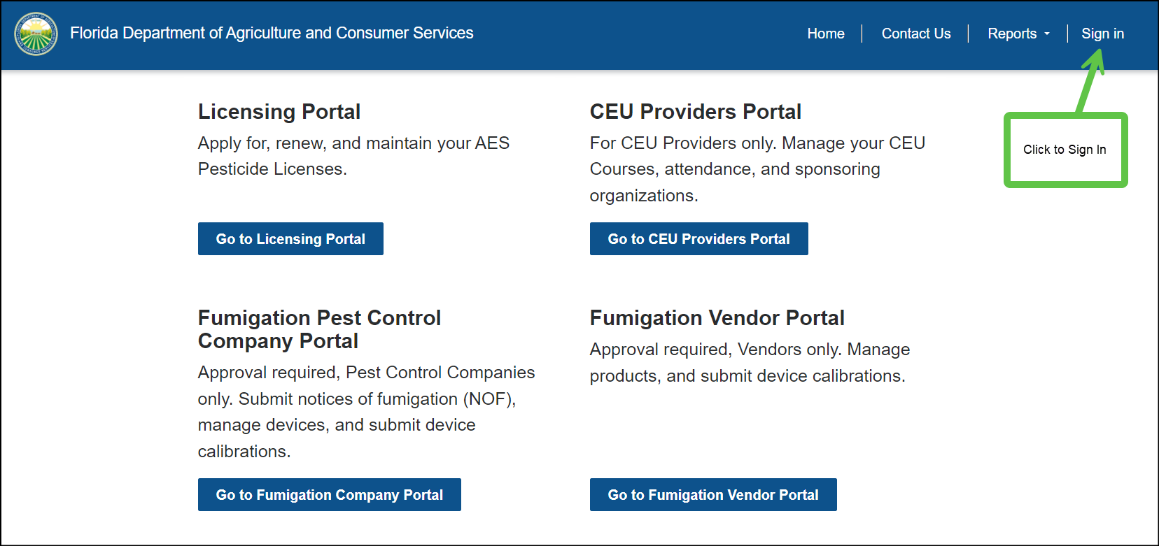
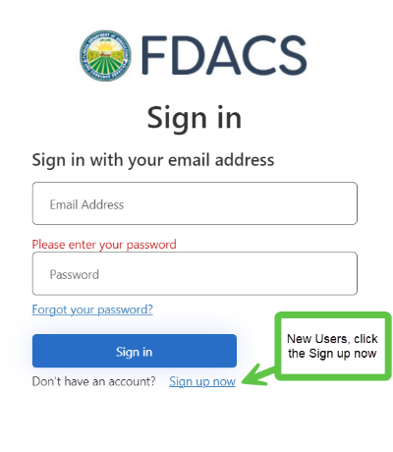
New User Sign Up
Go to https://aeslicensing.fdacs.gov

Slide 6
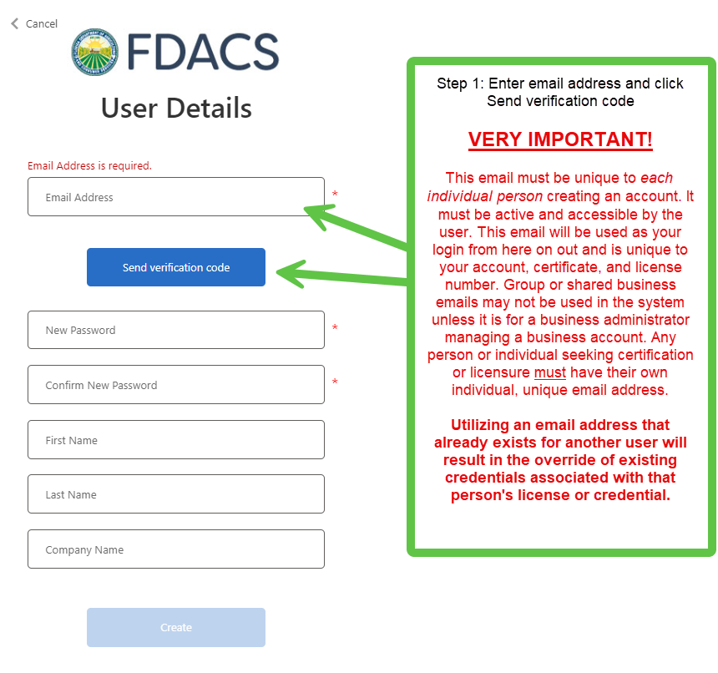
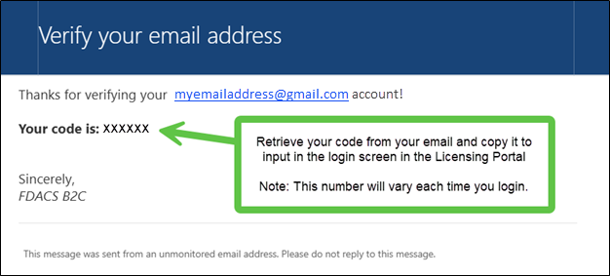
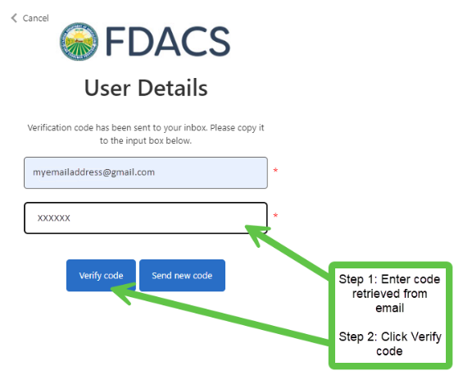
New User Sign Up 1
Check your email account for the verification code.
It will now say E-mail address verified. You can continue now.

Slide 7
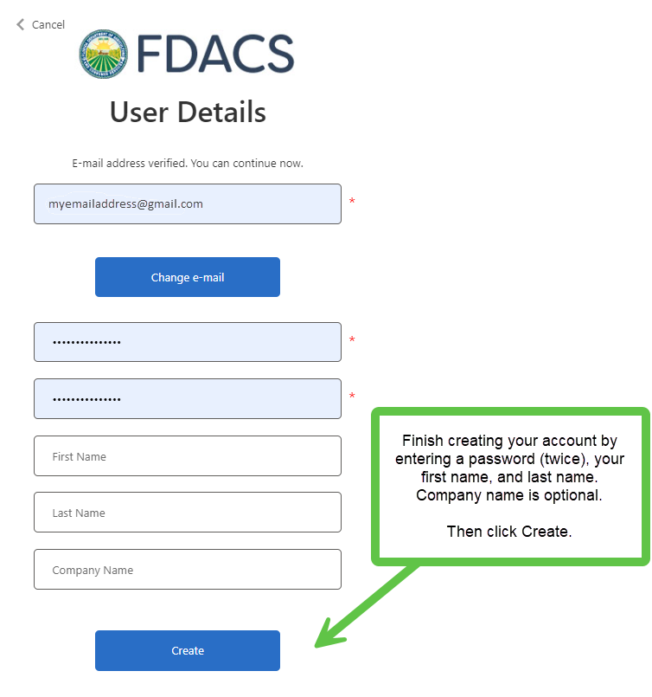
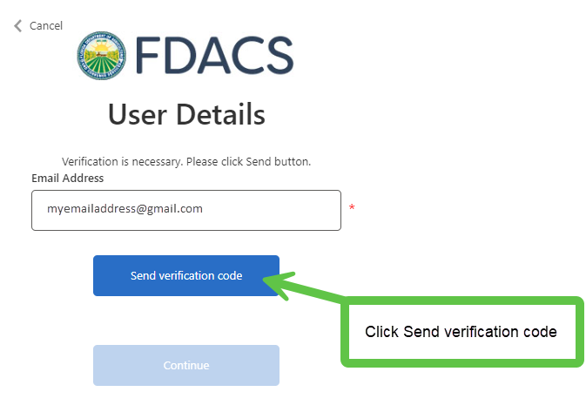
New User Sign Up 2
Now that your account is created, you may proceed with login when presented with the below screen.
Check your email account for the verification code.

Slide 8
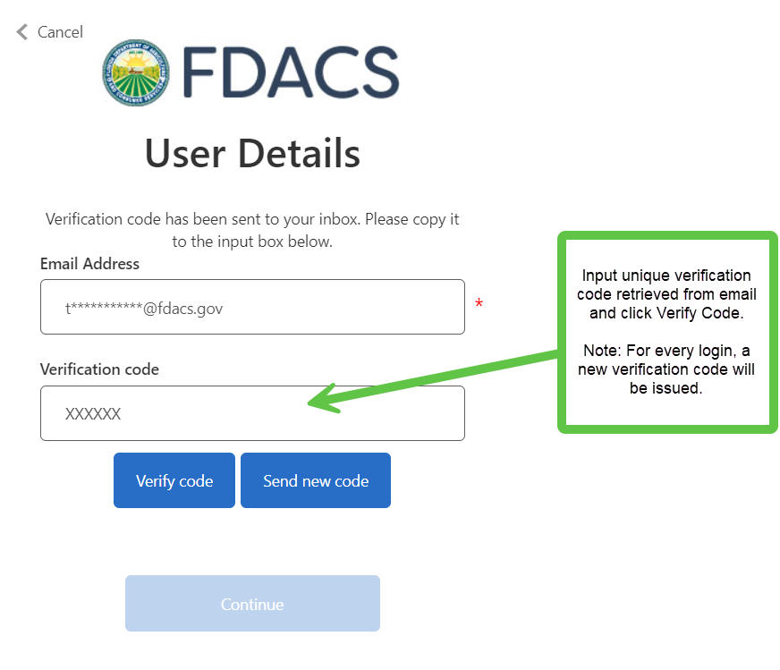
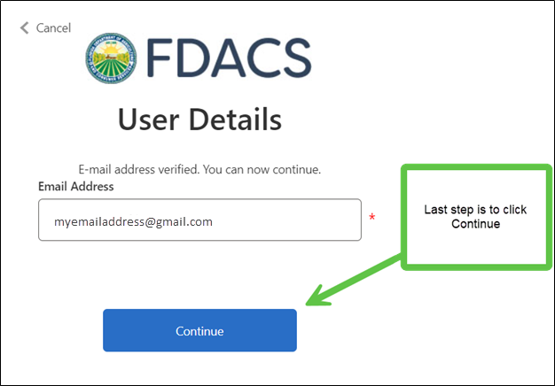
New User Sign Up 3
You will now be logged into the Licensing Portal.
Insert the 2nd verification code and click Verify Code.

Slide 9
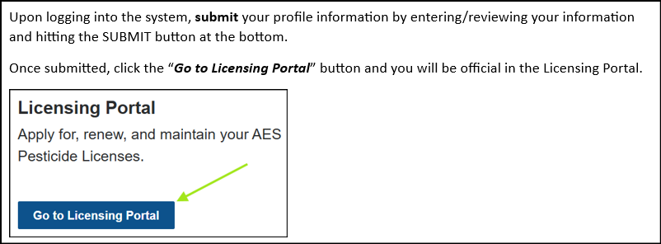
New User Sign Up 4

Slide 10
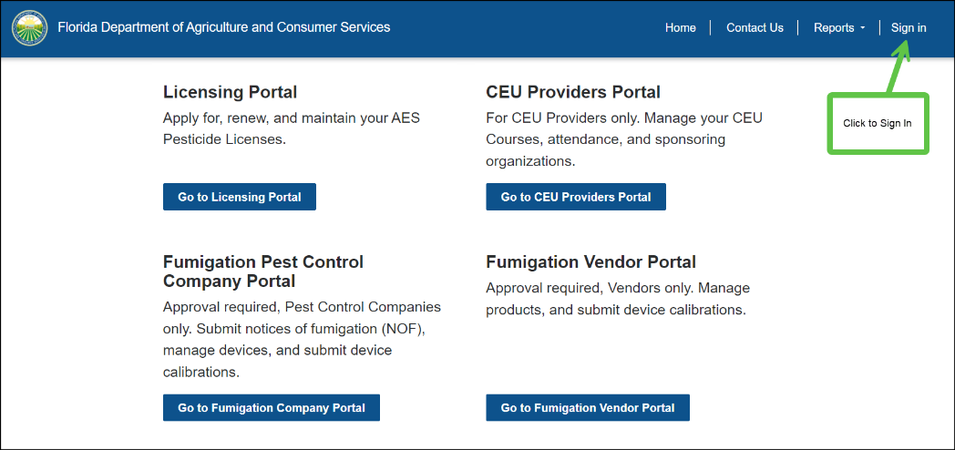
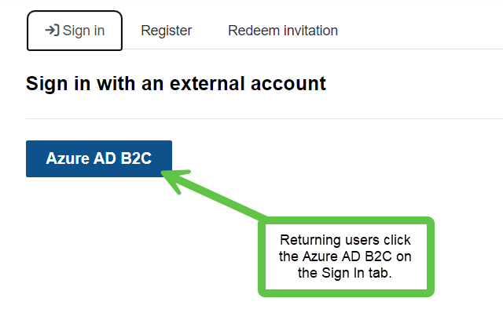
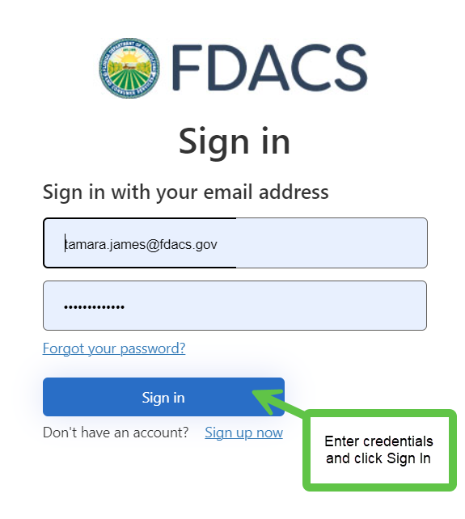
Returning User Login 1
1.
2.
3.

Slide 11
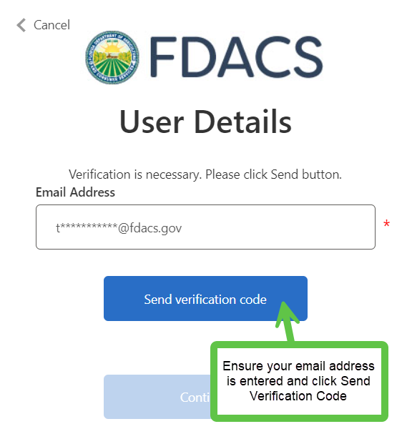
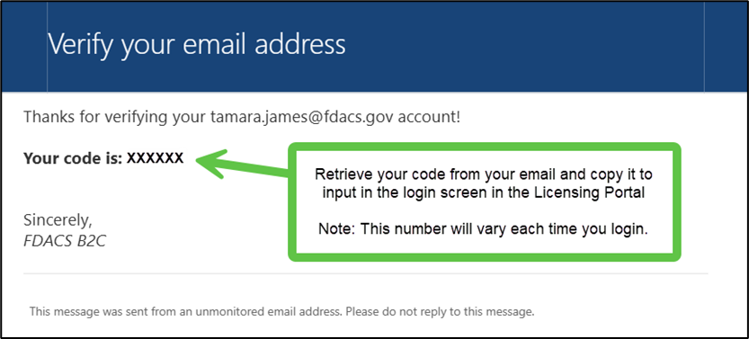
Returning User Login 2
Check your email account for the verification code.

Slide 12
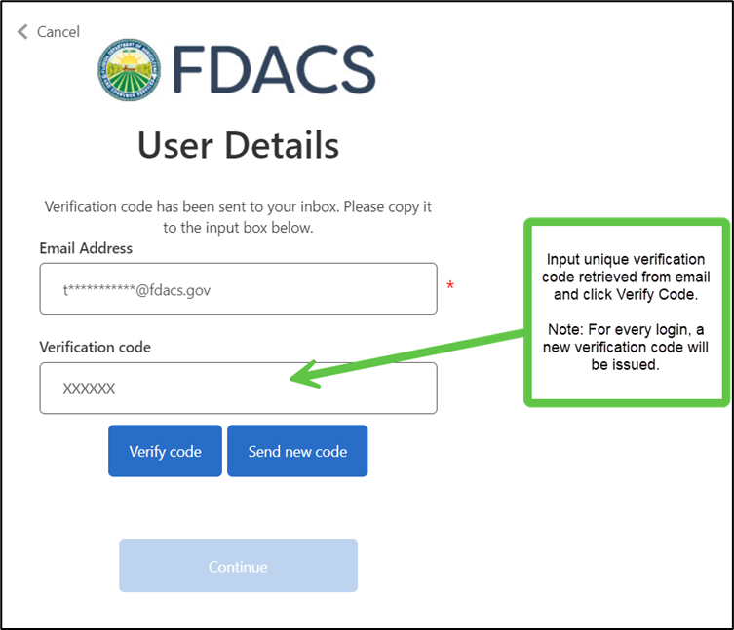
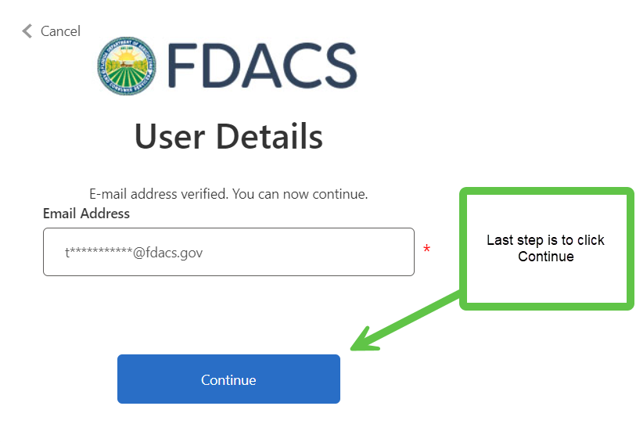
Returning User Login 3
You will now be logged into the Licensing Portal.

Slide 13
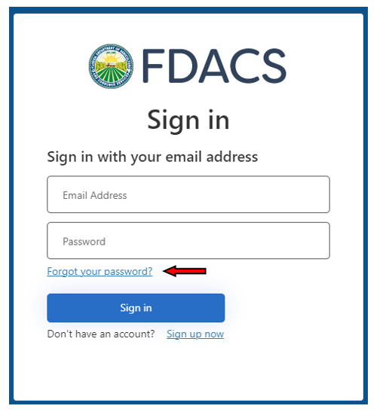
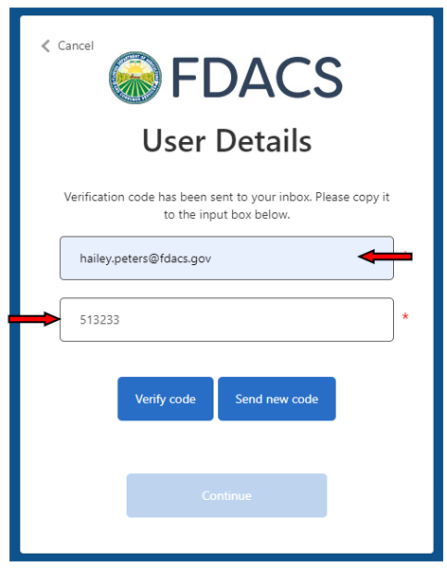
How to Reset Your Password 1
Enter you email address and select “Send Code.”
Enter the code and select “Verify Code”.
On the “Sign In” page click “Forgot your password?”.

Slide 14
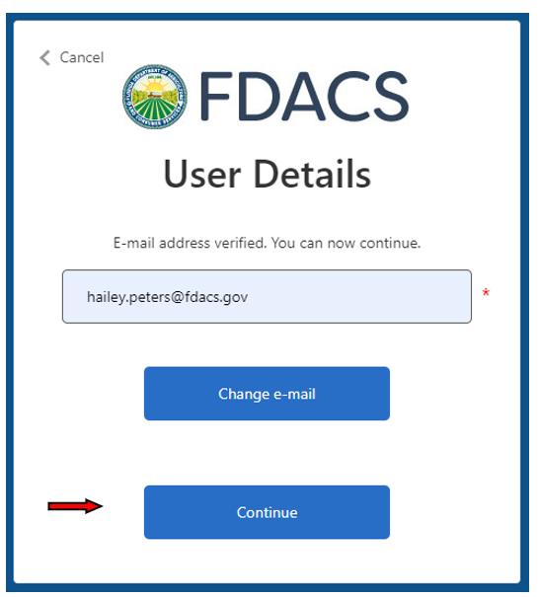
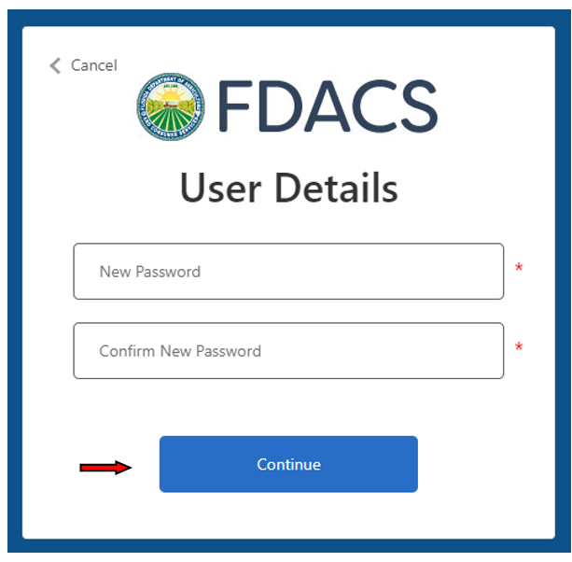
How to Reset Your Password 2
You will then be prompted to enter your New Password and then re-enter the password for confirmation.
Click “Continue” after completion.
Click “Continue”

Slide 15
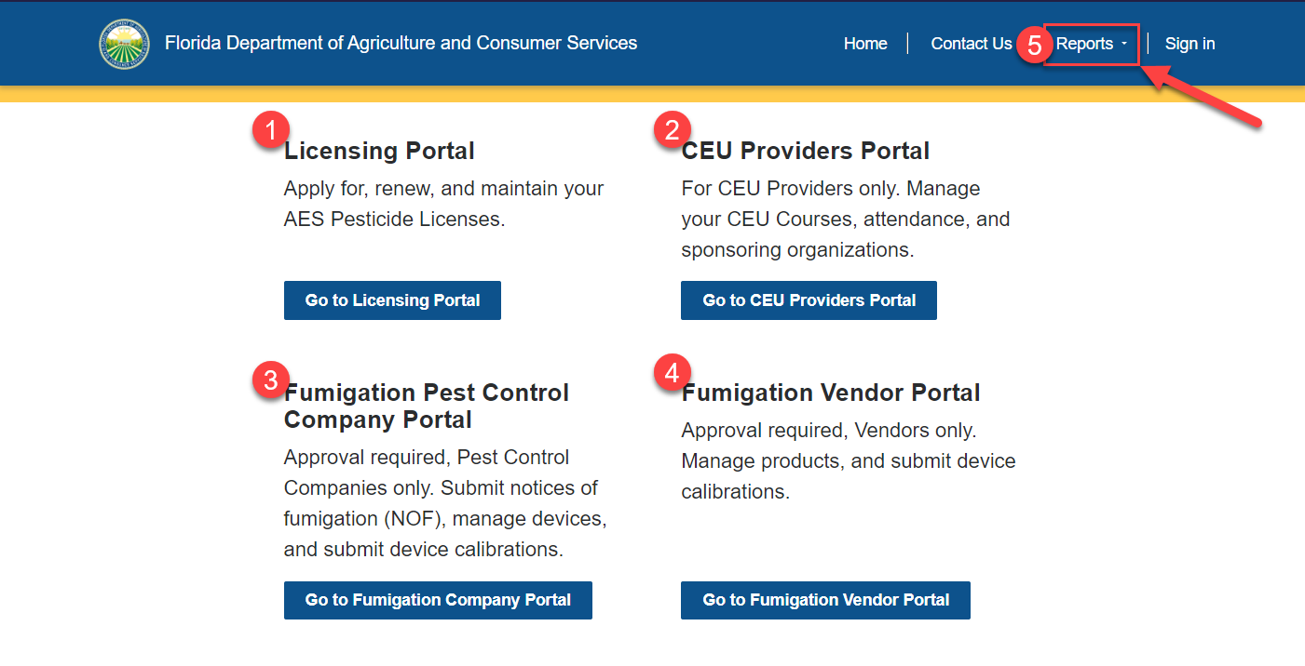
2 | Portal Overview
Go to https://aeslicensing.fdacs.gov to access the FDACS AES Portal.

Slide 16
Portal Overview
You will be presented with several options upon visiting the Main Portal Home Page.
Upon sign in, you will have to make a determination on which portal to enter or which menu to access at the top of the page.
The options are Home, Contact Us, Reports, and you will see your name with the option of a drop-down menu which will take you to your profile where you can update your personal information.
Each portal has a description of its contents.

Slide 17
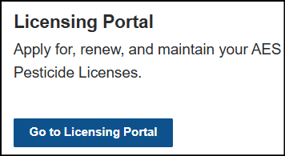
Portal Overview: Licensing Portal
1. Licensing Portal - For all licensing-related processes and applications for Chapter 388, 482 and 487.

Slide 18
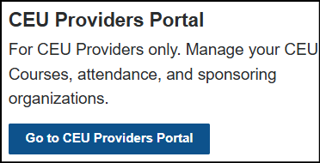
Portal Overview: CEU Providers Portal
2. CEU Providers Portal - For CEU Providers looking to manage new and renewed CEU courses and add attendees, click the CEU Providers Portal.

Slide 19
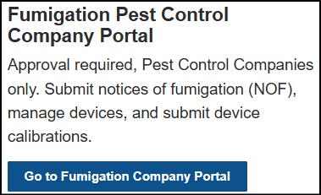
Portal Overview: Fumigation Pest Control Company Portal
3. Fumigation Pest Control Company Portal - For Fumigation Pest Control Companies needing to submit Notices of Fumigation, manage devices, and submit device calibrations, click Fumigation Pest Control Company Portal to request access since department approval is required for this portal.

Slide 20
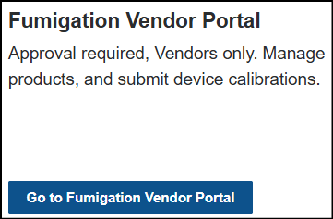
Portal Overview: Fumigation Vendor Portal
4. Fumigation Vendor Portal - For Fumigation Vendors needing to manage products and submit device calibrations, click Fumigation Vendor Portal to request access since department approval is required for this portal.

Slide 21
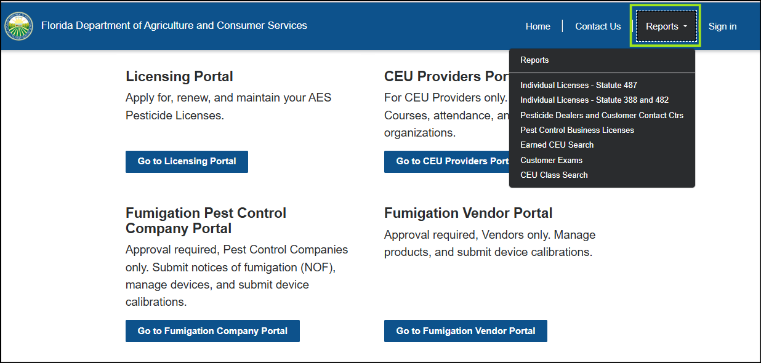
Portal Overview: Reporting
5. The Reports drop-down menu can be accessed without logging into the system. The screenshot below shows the options for reports.

Slide 22
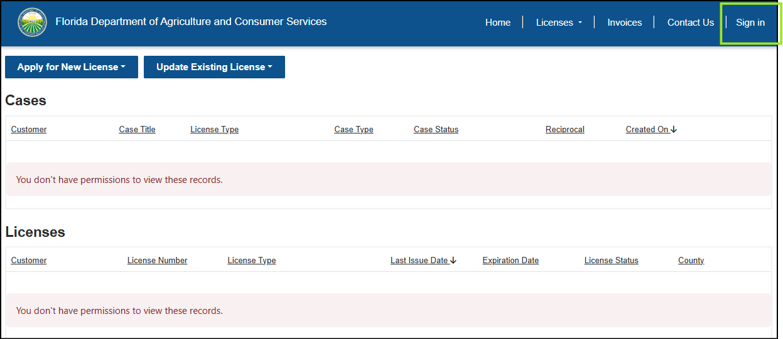
Portal Overview 1
NOTE: If you click to enter a portal before signing in, even if you have previously accessed the portal, you will either be prompted to login or told you don’t have permission. You must then Sign In if that’s the case.

Slide 23
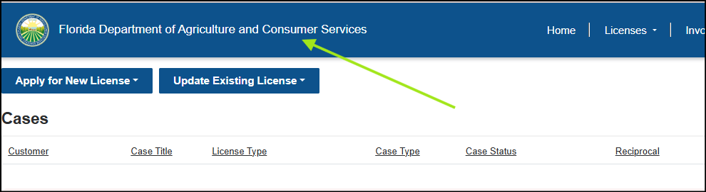
Portal Overview 2
To return back to the initial login/home screen outside of a portal, you must click the Florida Department of Agriculture and Consumer Services button in the Header.

Slide 24
3 | General Licensing Portal Navigation
View Case History
Access License History
Self Service Access to View PDFs of Licenses & Certificates
View Pending & Completed Exams & Vouchers
Invoice Management
Manage Access to Cases
Updating Licensee Profile
Business Email Field

Slide 25
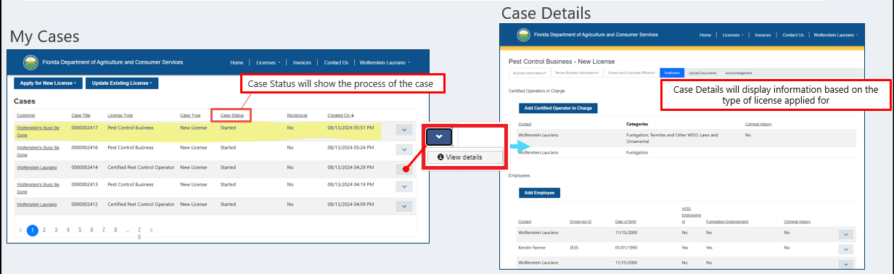
Licensing Portal | View Case History
Licensing Portal
Cases
Case Details

Slide 26
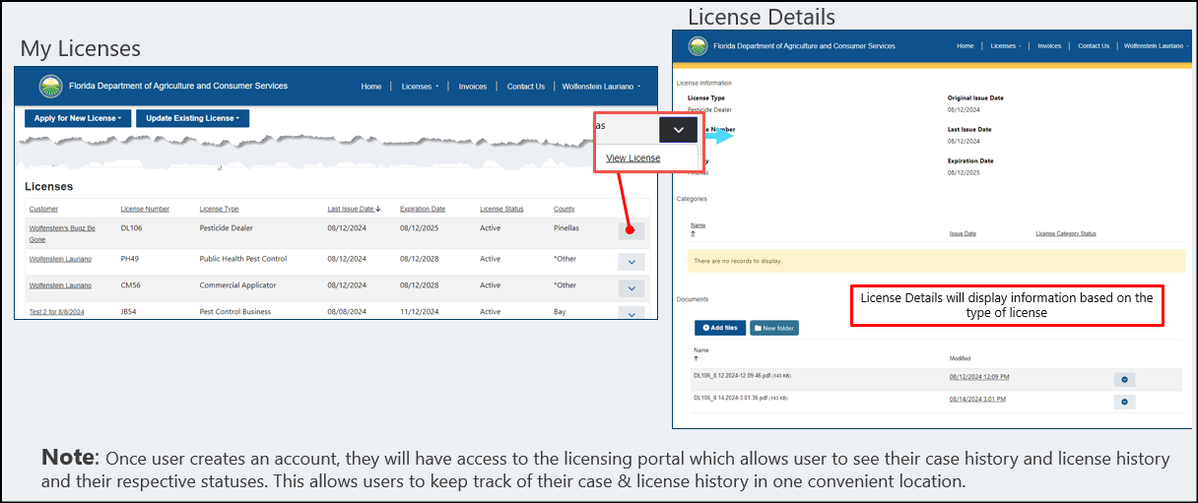
Licensing Portal | License History
Licensing Portal
Licenses
License Details

Slide 27
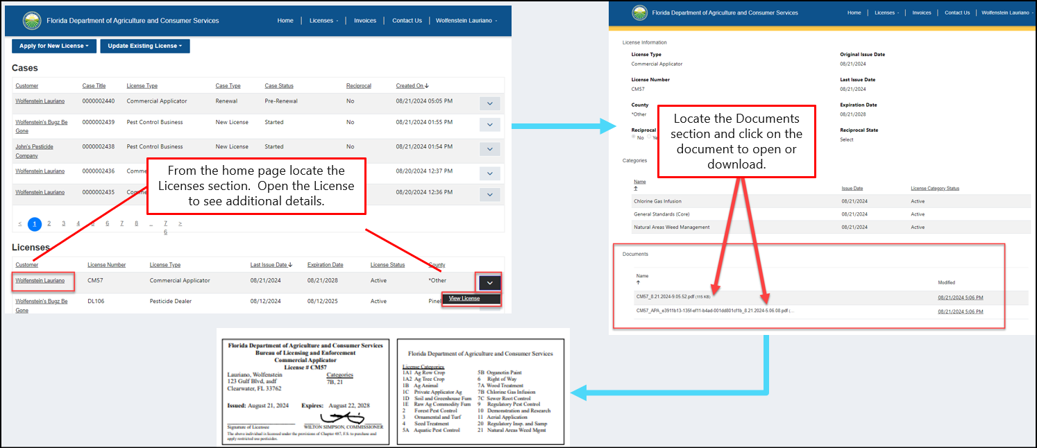
Licensing Portal | View PDF License Docs
Option 1
NOTE: Licensees can view and download PDF licenses directly on the portal.

Slide 28
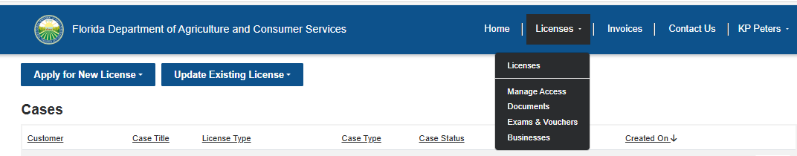
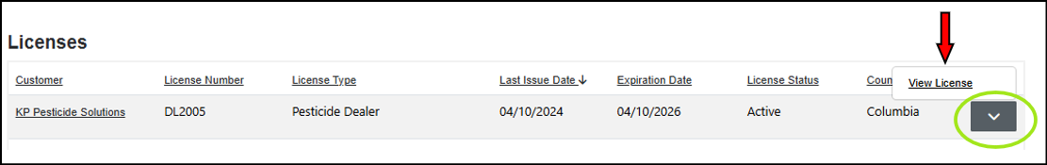
Licensing Portal | View PDF License Docs 1
Option 2
Select the dropdown arrow next to the license you need a copy of and then click View License.

Slide 29
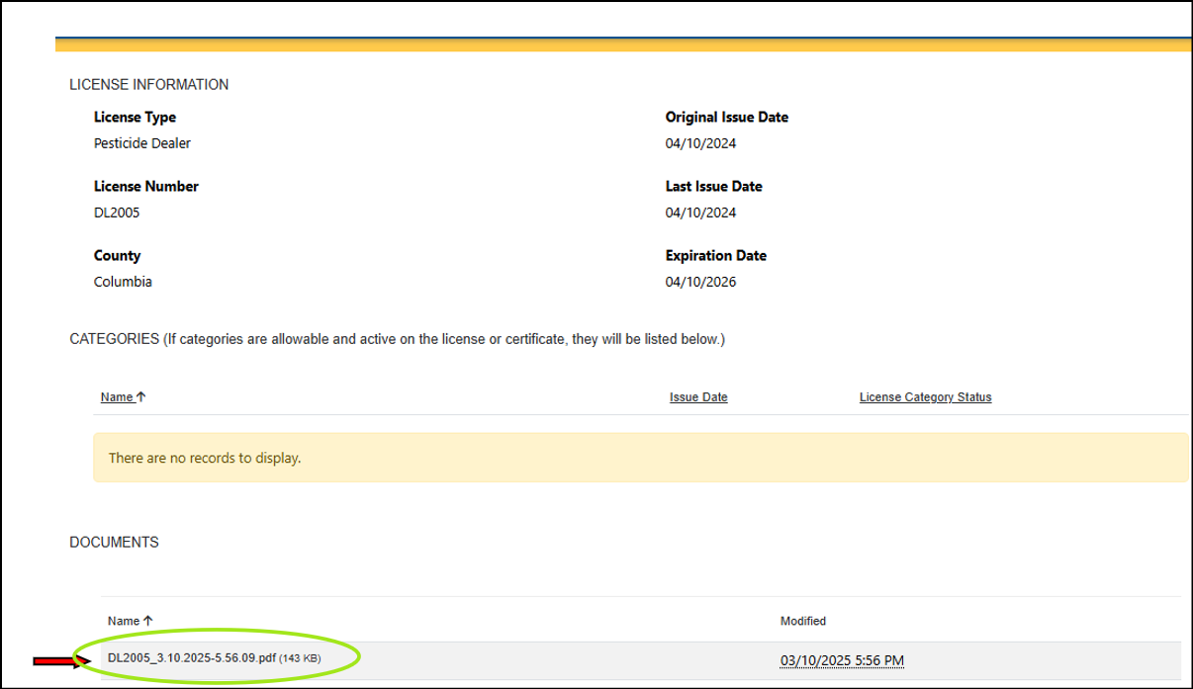
Licensing Portal | View PDF License Docs 2
Option 2
Click on the document shown under the “DOCUMENTS” category to download and save the PDF. The license will automatically download. A downloads table will populate, you can click on the license from there to open it.

Slide 30
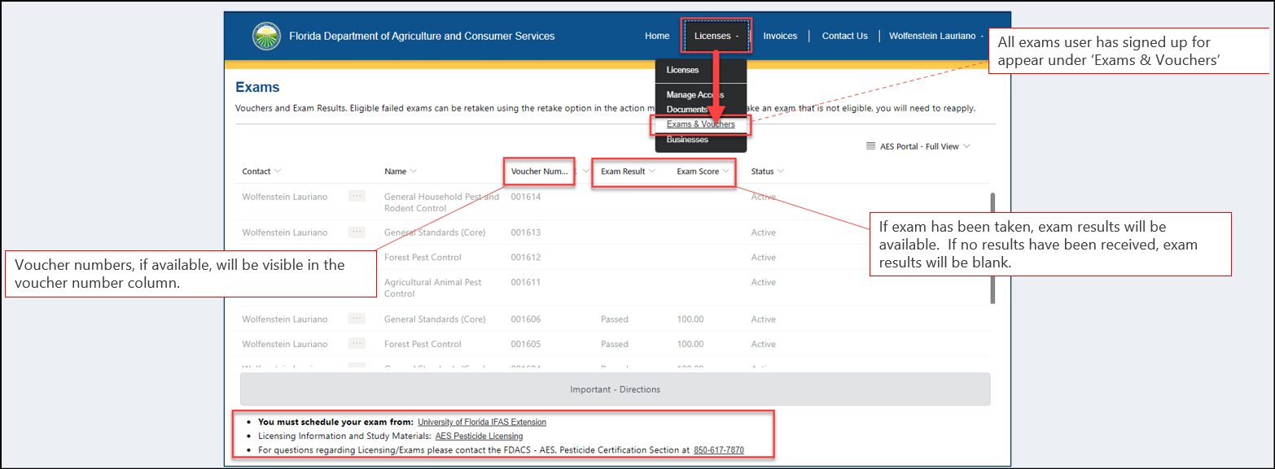
Licensing Portal | Exams & Vouchers
Licenses Portal
Licenses
Exams & Vouchers
NOTE: Timing for exam & voucher number visibility is based on the license type and payment status of application/license.

Slide 31
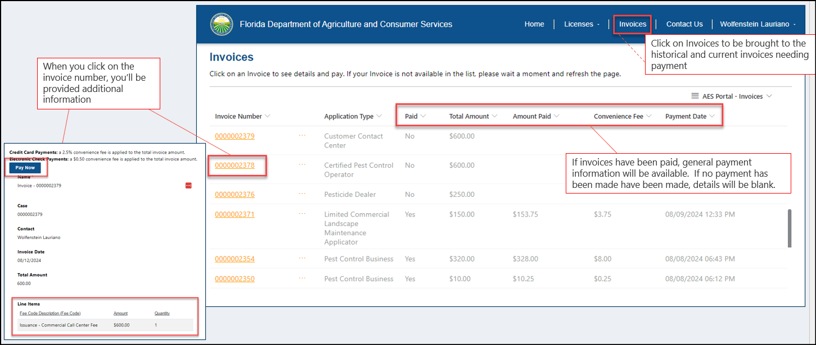
Licensing Portal | Invoice Management 1
NOTE: When a user clicks on the invoice number, they will be taken to a page that shows additional information about the Invoice. They will also have the ability to click on the “Pay Now” button to complete payment in the secure checkout. Invoice emails will also be distributed and can be sent to another person to complete the payment.

Slide 32
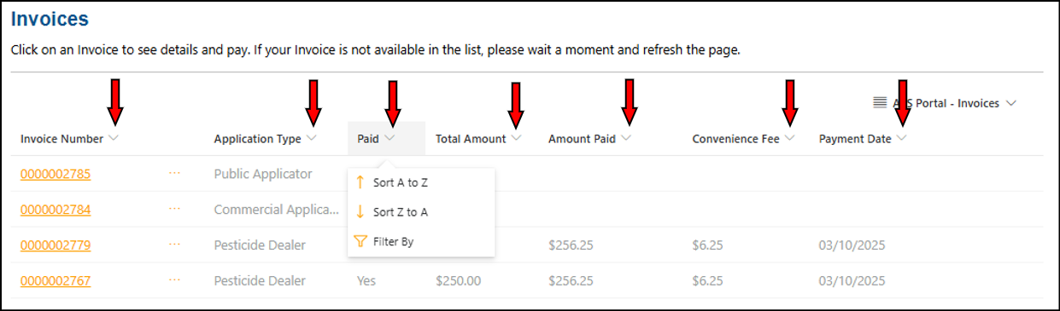
Licensing Portal | Invoice Management 2
You can filter/sort the invoices using the arrow down next to the column titles.

Slide 33
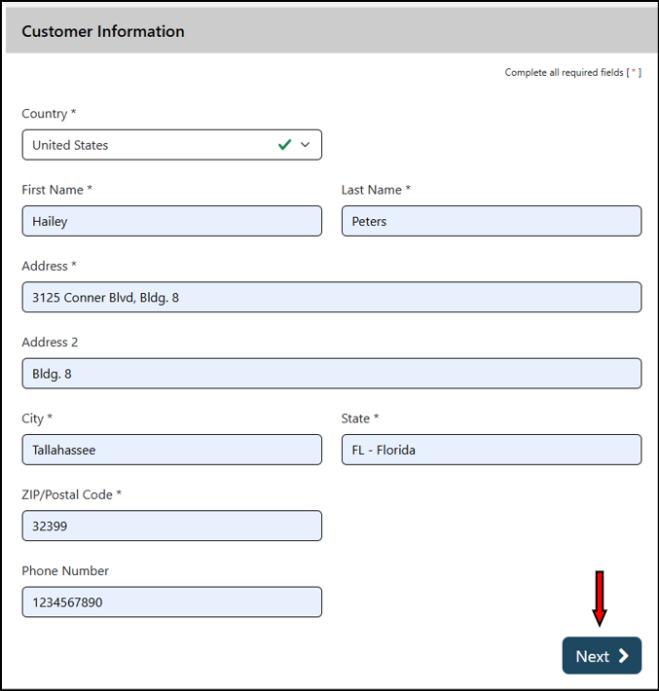
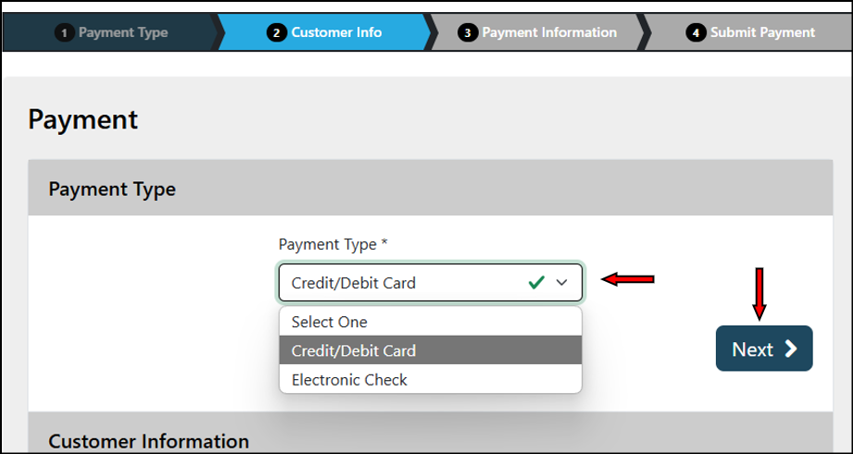
Licensing Portal | Invoice Management 3
To make an actual payment, click PAY NOW and continue with payment as instructed:
Select payment type
Click “Next”

Slide 34
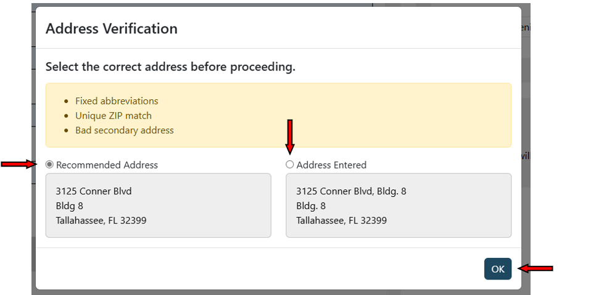
Licensing Portal | Invoice Management 4
You may receive an Address Verification box populated with a recommended address. Double check the address and determine if you want to continue forward with the address you entered, or if you want to use the Recommended Address.
  - Select “Next”

Slide 35
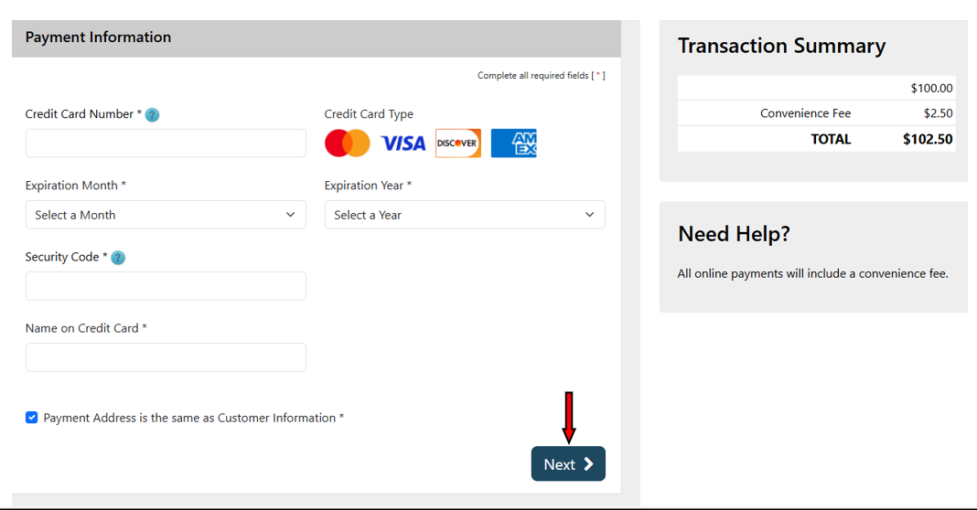
Licensing Portal | Invoice Management 5
Enter your payment information, and click “Next”
  - If you no longer wish to move forward with the payment, select “Cancel”

Slide 36
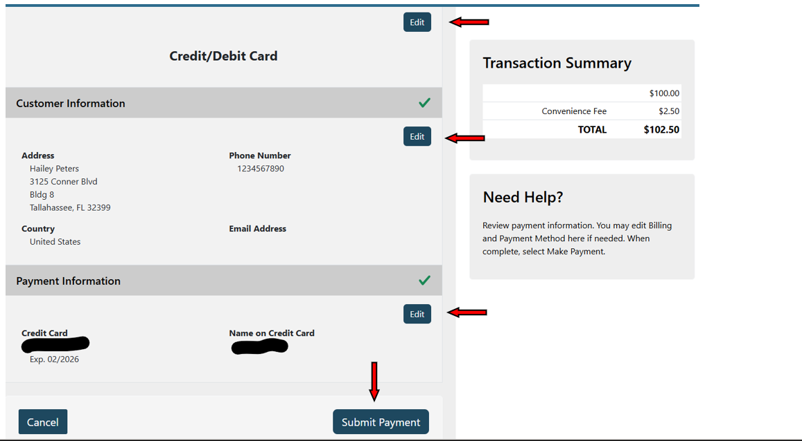
Licensing Portal | Invoice Management 6
Review the information entered. If everything is correct, proceed by clicking “Submit Payment”.
  - If you need to make changes, select “Edit” on any of the fields that require correction.

Slide 37
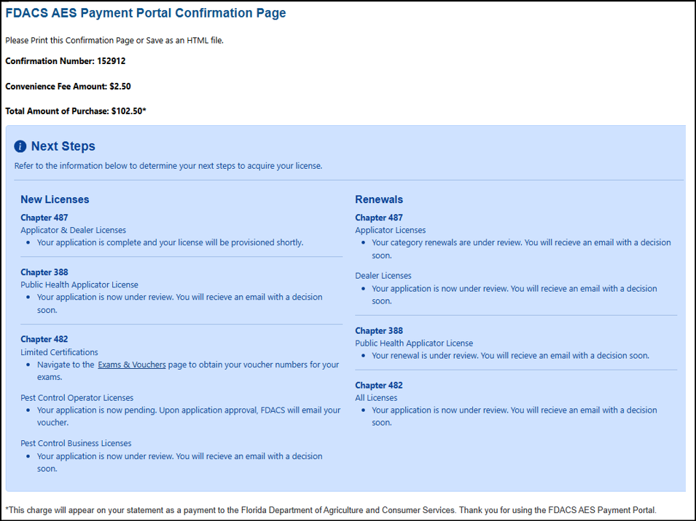
Licensing Portal | Invoice Management 7

Slide 38
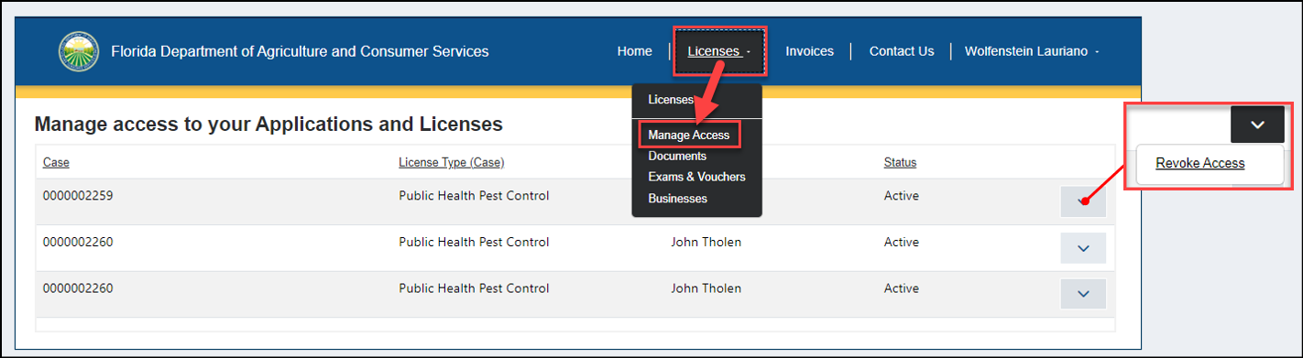
Licensing Portal | Manage Access
Licensing Portal
Contact Us
Manage Access
NOTE: This area will show the additional portal users who have access to the cases that have been submitted for you, as the licensee. You can revoke access at any point by clicking on the ‘Revoke Access’ option.

Slide 39
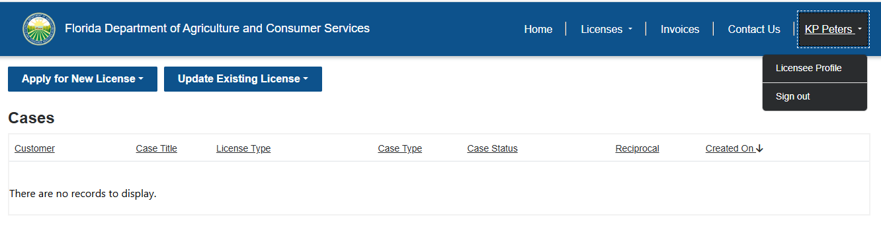
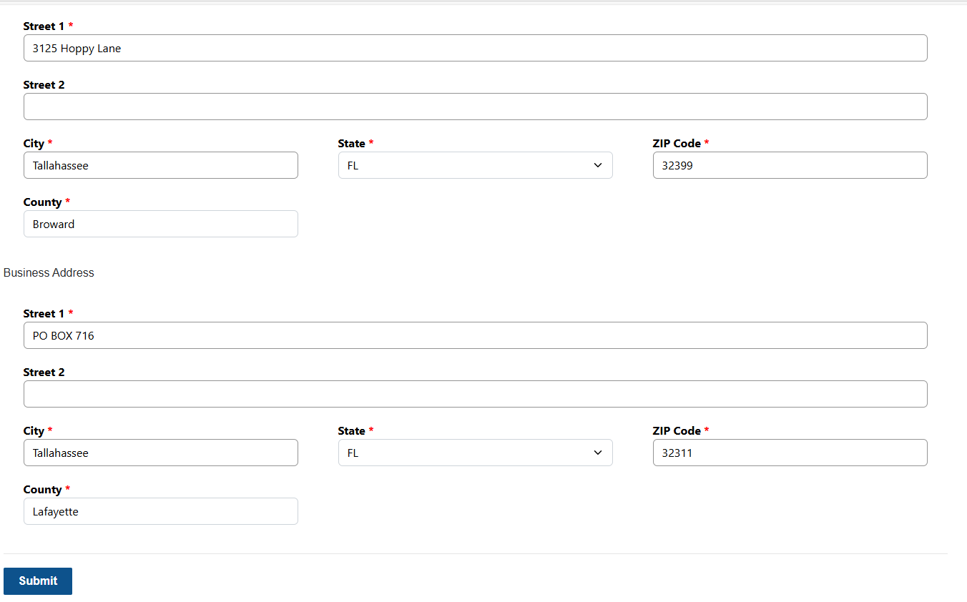
Licensing Portal | Updating Licensee Profile
Click on your name at the top right.
Select “Licensee Profile”.
Update the information needed, then click “Submit”.

Slide 40

Licensing Portal | Business Email Field
IMPORTANT:
Business Email field (Optional): If provided, the business email address will receive a copy of all Renewal Notice(s) and Invoice(s) for the Licensee or Certificate Holder. Updating the business email during an application will not result in the same action; this action only works if the business email address field is updated on the LICENSEE PROFILE.

Slide 41
4 | Chapter 487 License Navigation
Click the desired link below (in blue) to open the Tutorial in the Department’s SharePoint site.
Apply for a New License (CM, PV, PB)
Renew an Individual License (CM, PV, PB)
Apply for a New License (DL)
Renew a Dealer License (DL)
Apply for a Reciprocal License
Add a Category
Retake a Failed Exam

Slide 42
5 | Chapter 388 License Navigation
Apply for a New Public Health Pest Control (PHPC) License
Renew a Public Health Pest Control License

Slide 43

Apply for a New PHPC License 1

Slide 44

Apply for a New PHPC License 2
NOTE: For Public Health Pest Control license applications, vouchers will be provided to the portal user immediately. No payment is required. A case is created for the FDACS staff for references but will not be in their working list at this time.

Slide 45

Apply for a New PHPC License 3
Resolve Case & Issue License:
If the license being applied for is a 388 Public Health Pest Control License, their Case will need to be resolved by an FDACS staff member in CRM. The email will be sent to the email address on record for the Business and their license will be attached.

Slide 46

Renew a PHPC License 1

Slide 47

Renew a PHPC License 2

Slide 48

Renew a PHPC License 3

Slide 49

Renew a PHPC License 4

Slide 50

Renew a PHPC License 5
After submission of the renewal application, the renewal case will be reviewed by the Licensing Team. If all requirements are met, then the license will be issued and sent via email.

Slide 51
6 | Chapter 482 License Navigation
Click the desired link below (in blue) to open the Tutorial in the Department’s SharePoint site.
Adding a Secondary Contact to a Business License
Pest Control Business License
  New
  Renew
Certified Pest Control Operator Certificate
  New
  Renew
Special Fumigation ID Card
Limited Certificate(s)
  New LC, LW, LL, LS
  New LF
  Renew
Employee ID Card(s)

Slide 52
Adding a Secondary Contact to a Business License 1
This Primary Contact will have the ability to manage the JB licenses and all associated processes for that company and location within the portal.
Once the primary contact is logged in to the Portal and the businesses are showing available, a secondary contact (a different person with a unique individual email address) can be assigned to each JB in the primary’s portal, if desired. The secondary contact will be able to manage the JB at the same level of the primary contact.
To Designate a Secondary Contact: The Primary Contact will login to the site (on or after 4/1/25) at https://aeslicensing.fdacs.gov. Once signed in, click Go to Licensing Portal. Within the portal, go to the top right menu: Licenses > Businesses. Click the drop down arrow next to each JB that you want to add a secondary contact for and then click "Update Secondary Contact". You will then enter the secondary contact's email and click SUBMIT to save. NOTE: The secondary contact will need to register in the portal and setup their account prior to being added as the secondary contact.

Slide 53

Adding a Secondary Contact to a Business License 2

Slide 54
7 | CEU Portal
Click the desired link below (in blue) to open the Tutorial in the Department’s SharePoint site.
Register for the CEU Portal
Add a Co-Provider
Submit a New CEU Program
Manage Attendance and Add Attendees
Add a Class to an Approved Program
Renew a Program

Slide 55
8 | Fumigation Portal
Click the desired link below (in blue) to open the Tutorial in the Department’s SharePoint site.
Pest Control Company
Equipment Vendor
Product Vendor

Slide 56
9 | Reports
Licensing Reports
Earned CEU Search
Customer Exams
CEU Class Search (Available CEUs)

Slide 57


Licensing Reports 1
Go to https://aeslicensing.fdacs.gov to access the FDACS AES Portal then click the Reports drop-down menu and select any of the license/certificate report options.
To make the report pop-out for easier viewing, click the bottom right pop-out arrow to open in a new, larger window.

Slide 58

Licensing Reports 2
By default, the entire list of licenses for the type of report you click into, will populate. You can also change the search fields at the top by license type, licensee name, license #, county, or category. If a licensee has Authorized Purchasing Agents they will be listed at the bottom.

Slide 59

Licensing Reports 3
  For pest control businesses, you can search them all by default, or put in the license number. Associated employees and Certified Operators designated as In Charge, will be visible on the reports.

Slide 60

Earned CEU Search
Go to https://aeslicensing.fdacs.gov to access the FDACS AES Portal then click the Reports drop-down menu and select Earned CEU Search.
To make the report pop-out for easier viewing, click the bottom right pop-out arrow to open in a new, larger window.

Slide 61

Earned CEUs
Type in the individual’s license or certificate number in the first field. There is no enter button. Just enter the data and the report will update/refresh. NOTE: You cannot export any reports from the public search page. You’ll see the list of Courses attended and the CEUs for each course displayed at the very bottom.

Slide 62

Customer Exams 1
Go to https://aeslicensing.fdacs.gov to access the FDACS AES Portal then click the Reports drop-down menu and select Customer Exams.
To make the report pop-out for easier viewing, click the bottom right pop-out arrow to open in a new, larger window.

Slide 63

Customer Exams 2
Utilize the search fields at the top to put in information that you want to search for. You can search by statute, exam dates, exam type, administrator, and the exam site. There is no enter button. Just enter the data and the report will update/refresh. Use the scrolling horizontal bar at the bottom to see all applicable information. NOTE: You cannot export any reports from the public search page.

Slide 64

CEU Class Search (Available CEUs) 1
  Go to: https://aeslicensing.fdacs.gov

Slide 65

CEU Class Search (Available CEUs) 2
  Scroll down to “CEU Class Search
  A list of “CEU Classes will appear.

Slide 66

CEU Class Search (Available CEUs) 3

Slide 67

CEU Class Search (Available CEUs) 4
  To filter search: Look for approved CEU Class by –Class Start Date, –Sponsor, –County, –Class Type, –Category, –Class Status, or –Program ID

Slide 68

CEU Class Search (Available CEUs) 5
For example: Search class by Class Status

Slide 69

CEU Class Search (Available CEUs) 6
Available: CEU Classes

Slide 70

CEU Class Search (Available CEUs) 7
Select, the class. (It will appear in dark gray)
Categories box: shows the approved CEU credits for the select “Class”

